Slide 1
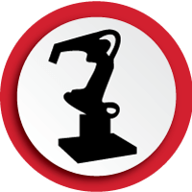
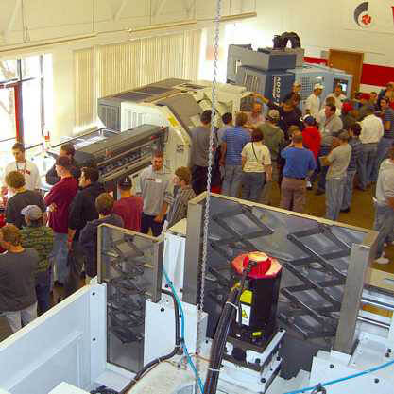
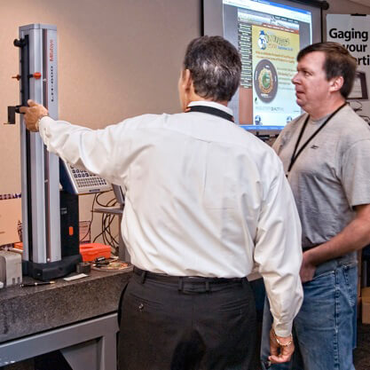
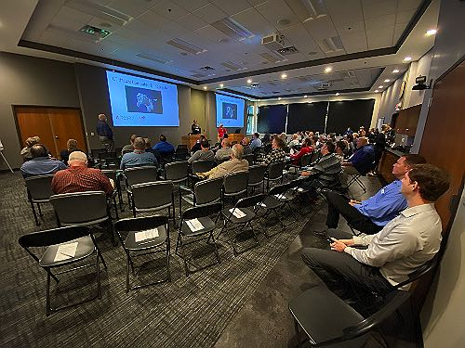
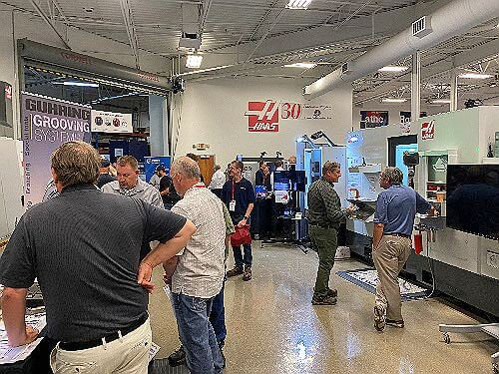
Newest Technologies in the Metalworking Industry
Intelligent Robotic Displays and Demos
Expert Seminars to Help Increase Your Knowledge in Machining
Lots of Prize Drawings
Machine Tools & Fabrication
Laser Cutting & Marking
Tooling & Accessories
Robotics & Automation
Service & Preventive Maintenance
Engineering Applications
Live Tool & Rotary Repair
Integrated Supply/VMI
Vending Systems
Used Machines
Measurement Solutions
Dimensional Inspection
www.productivity.com/oktoberfest-tool-show
Productivity Inc 15150 25th Ave. N. Plymouth, MN 55447

