Slide 1
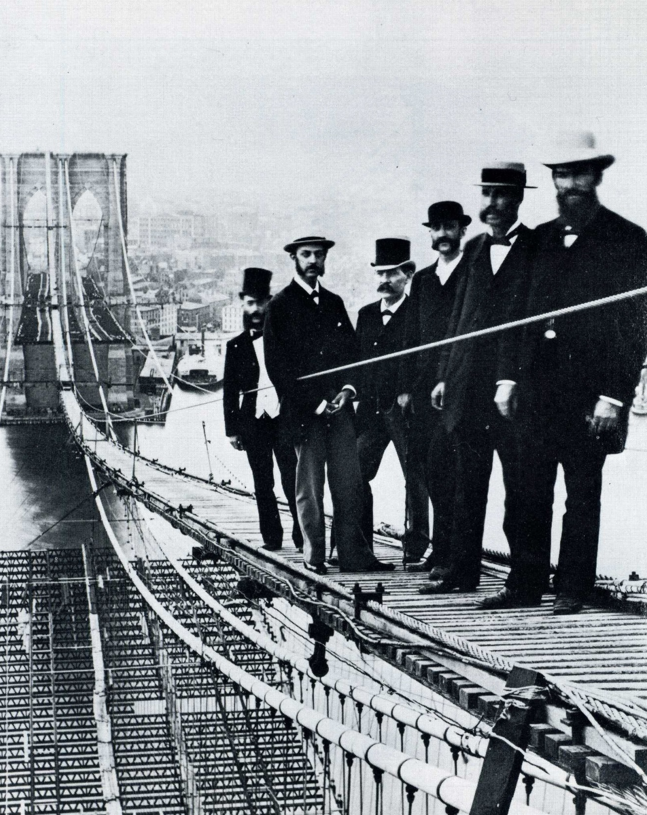
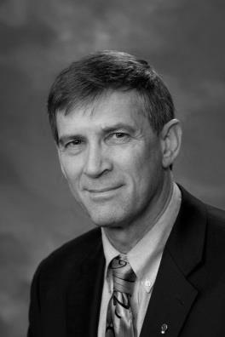
American Society of Civil Engineers – MSU Student Chapter
Paul Giroux
Senior Engineer
BUILDING BROOKLYN BRIDGE
The Untold Story
Veteran builder and award winning civil engineering historian Raymond “Paul” Giroux will share his in-depth research of the Brooklyn Bridge’s construction in a remarkable story as never before told. Utilizing historical photographs and stunning animations Paul will bring the construction of the Bridge to life.
Trafton East 225, 5:00 – 6:00p Wednesday, April 22, 2015
Winner: 2013 ASCE History and Heritage Award
Chairman Brooklyn Bridge 125th Anniversary
Closing Speaker Hoover Dam 75th Anniversary
Chairman Golden Gate Bridge 75th Anniversary
Featured Speaker Panama Canal 100th Anniv.
All students, faculty, and industry
professionals are welcome to attend
May 20, 1913

