Slide 1
SAE Clean Snowmobile Challenge 2008
Minnesota State University Mankato
Dylan Brandt, Nick Perkins, Abdulsalam Hamud, Wayne Minnichsoffer, Andrew Pickle
Notes:
11-27-2007 – Added title and team names to slide (AP)

Slide 2
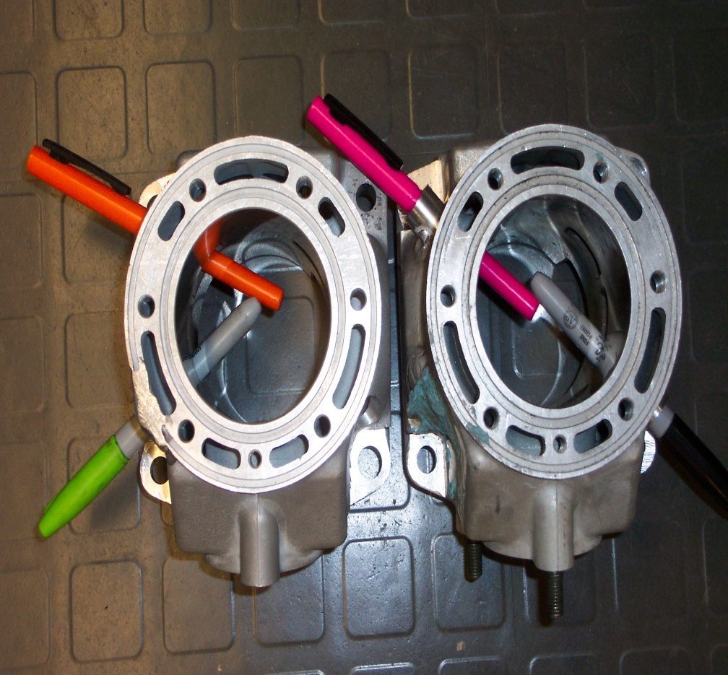
Engine Modifications
Semi-direct injection utilizing 2 injectors per cylinder (Plan A)
Semi-direct injection utilizing one injector in throttle body and one injector in the transfer port per cylinder (Plan B)
Researching compression ratios to utilize the full potential of the higher octane rating of E-85 fuel.

Slide 3
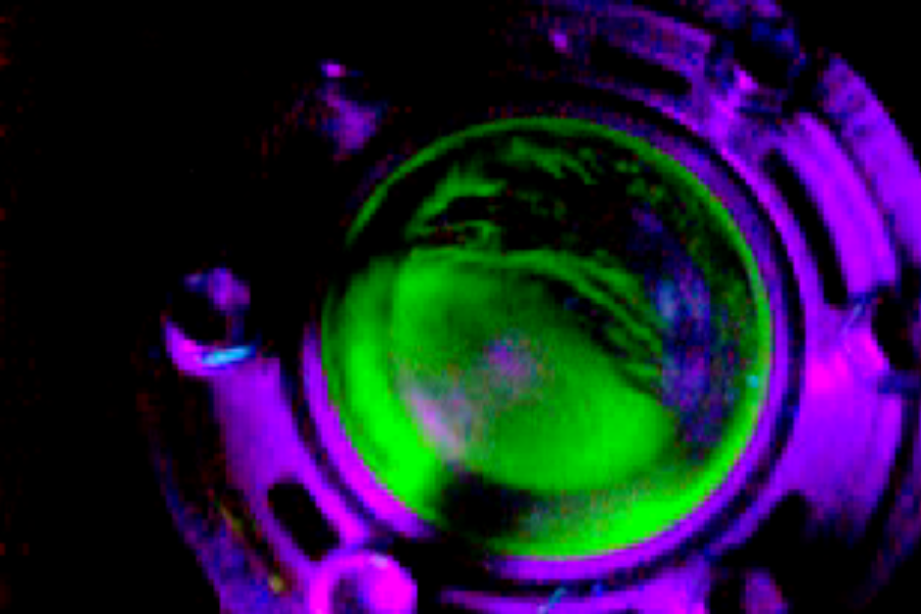
Engine Modifications
Replacing the carburetor from the Sabercat engine with a throttle body assembly from an Arctic Cat M7.
Used wet flow research to determine optimum injector placement locations and angles in the cylinder jugs.

Slide 4
Engine Management
Custom-designed timing wheel for use with the Motec M48 engine management system.
Utilizing the Motec M48 engine control system to control the ignition and fuel systems.
Notes:
11-27-2007 – added crank wheel drawing to slide (AP)

Slide 5
Engine Management
The Motec M48 utilizes a magnetic sensor to track crank rotation.
Allows us to finely control the ignition and fuel injection for best power and fuel economy.
Uses data from a variety of sensors to automatically compensate for varying air temperature and pressure.
Notes:
11-27-2007 – Added slide with more information about the Motec (AP)

Slide 6
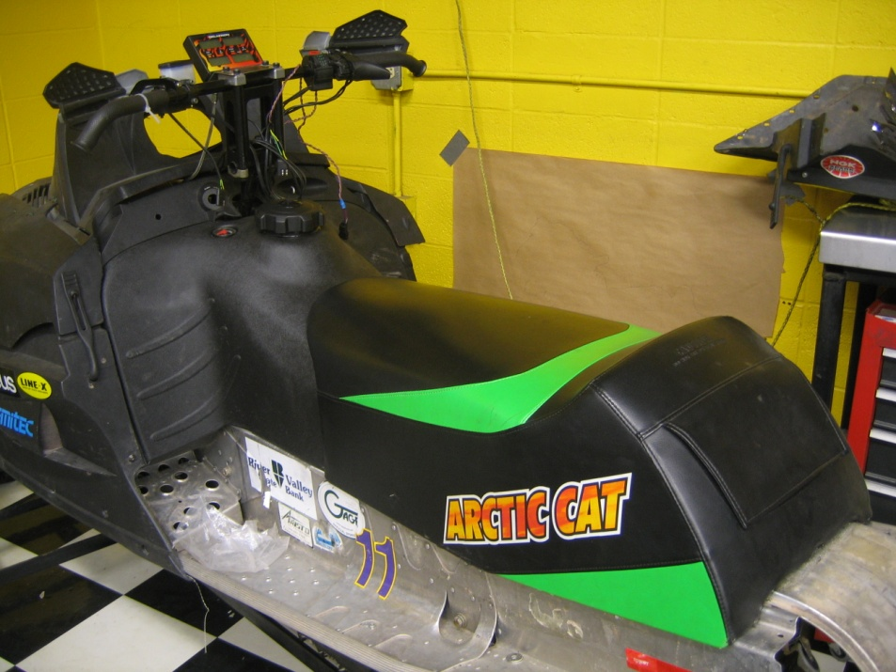
Chassis Modification
Utilized stock seat and tank for the best ergonomics and standard rider comfort.
Upgraded track to increase traction and improve handling.
Notes:
11-27-2007 – Added photo of stock tank/seat setup

Slide 7
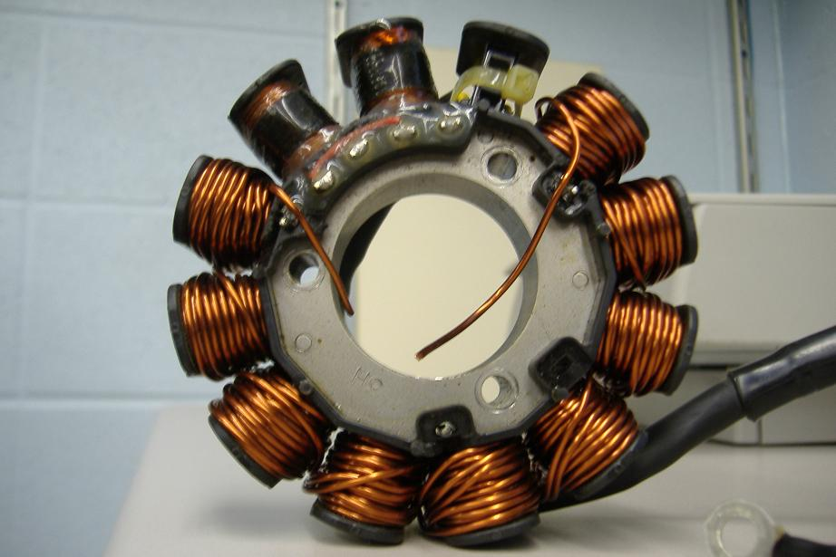
Electrical Modifications
Using upgraded stator from the 2007 team to increase the available electrical power.
Rewired the sled for the improved engine management system and other electrical modifications
Rewired headlights to improve light output.
Rewired kill switch to function as indicated.
Mounted battery away from exhaust. Used a smaller battery to reduce size and weight.
Notes:
11-27-2007 – Added photo of upgraded stator windings, changed title to “Electrical Modifications” (AP)

Slide 8
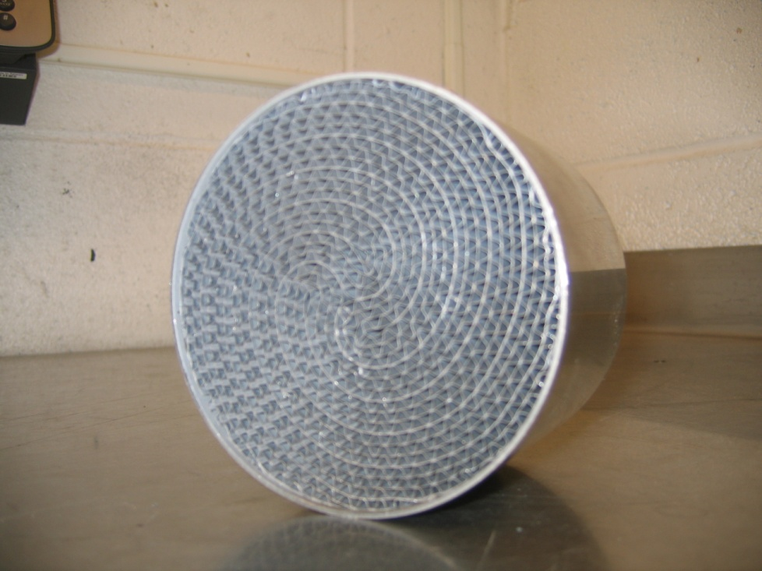
Emissions Modifications
Utilizing a three-way 60.5mm x 74.5mm catalyst from Heraeus to help clean the exhaust.
Secondary air injection used to improve catalyst efficiency.
Notes:
11-27-2007 – Added catalyst photo, catalyst size information, changed title to “Emissions Modifications”

Slide 9
Emissions Modifications
Secondary air pump is used to reduce HC and CO.
Air is pumped into the exhaust system.
Oxygen oxidizes the unburned HC and CO and turn them into water and carbon dioxide.
Reaction taking place is HC + CO + O2= H2O CO2
Electric air pump needs more amperage.
Air pump mounted and driven by the recoil.
The pump flowed 32 cubic feet of air per minute at 8000 RPM.
Notes:
11-27-2007 – Added slide with air pump information (AP + AH)

Slide 10
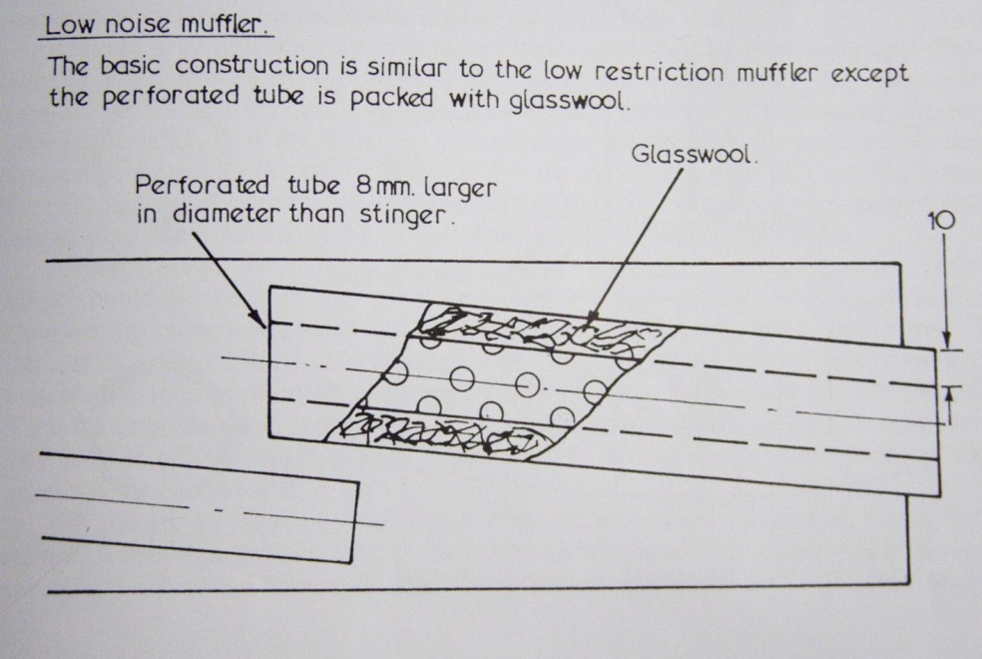
Noise Reduction
Redesigned exhaust system to utilize a muffler right after the tune pipe that uses glass wool packing to reduce noise and filter oil particulates in the exhaust.
Added noise-absorbing material to the under hood surface to reduce engine noise.
Notes:
11-27-2007 – Added picture of noise-reducing muffler (AP)

Slide 11
Questions?
Notes:
11-27-2007 - Added questions slide (AP)

