Slide 1
Performance of SolarWalls in Minnesota
Validity of Current Methods Used to Predict Energy Savings
By Michael Kiefer
Advisor: Dr. Patrick Tebbe
November 22, 2011
Department of Mechanical Engineering
Minnesota State University Mankato

Slide 2
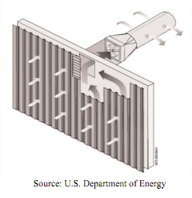
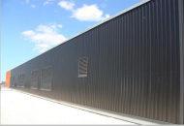
SolarWall Technology
Know as Unglazed Transpired Solar Collectors (UTC)
Solar radiation heats a dark metal surface that is perforated with small pin holes.
Air is pulled through the small pin holes creating a boundary layer
Heat is transferred to the air and is then distributed to the building through the HVAC system

Slide 3
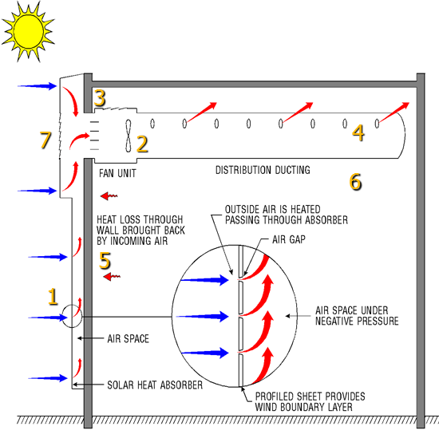
Key Features of Solar Wall Technology
Dark absorber sheet
Fan used to draw air into the ventilation system
Controls for bypass dampers and temperature
Source:RETScreen.com Course SAH PowerPoint

Slide 4
Key Features of Solar Wall Technology
HVAC System
Recaptured Wall loss
Destratification
Bypass damper used to vent heat not needed to the atmosphere
Source:RETScreen.com Course SAH PowerPoint

Slide 5
Methods used for Predicting Energy Savings
Department of Energy
Worksheet based on graphs produced from 30 years of data for solar radiation and Heating Degree Days
RETScreen Version 4
An Excel Based program that calculated energy savings based on user inputs

Slide 6
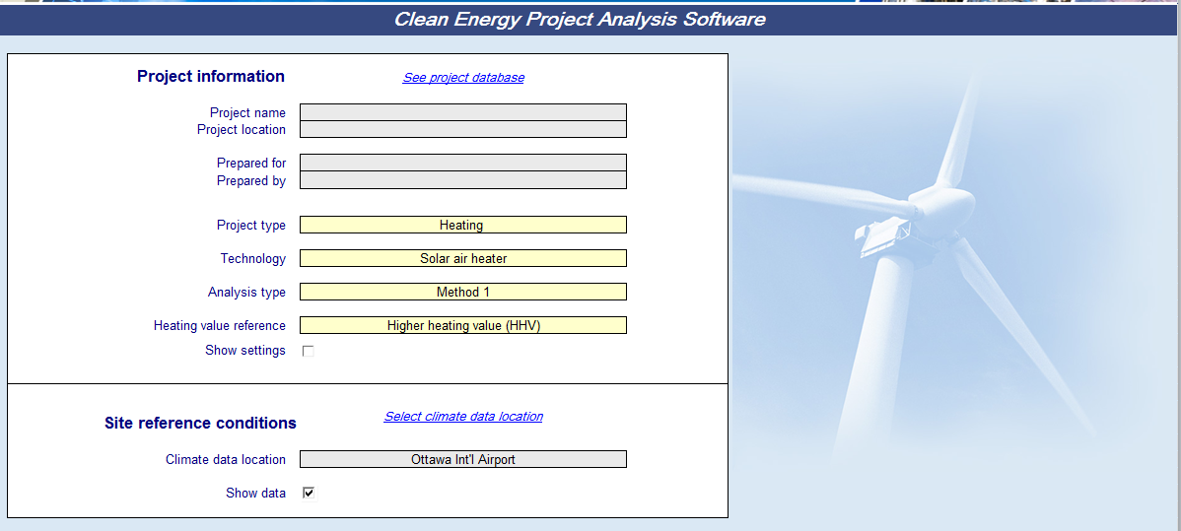
RETScreen Version 4

Slide 7
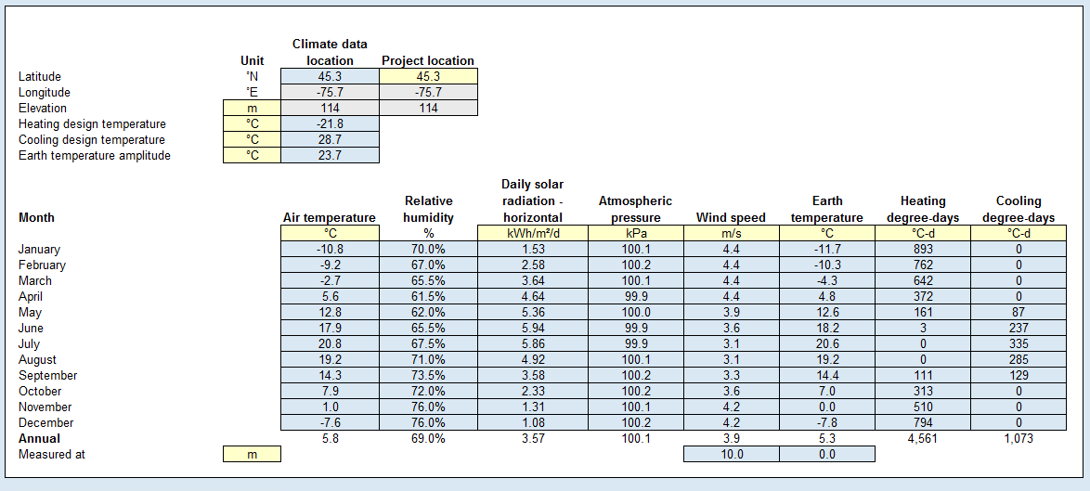
RETScreen Version 4

Slide 8
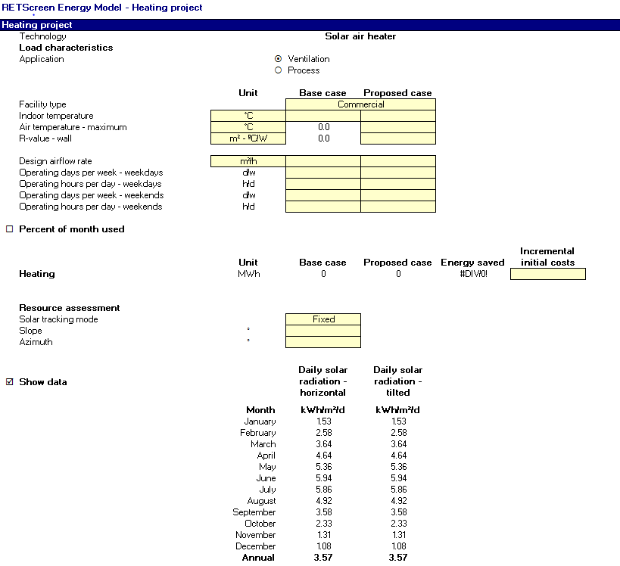
RETScreen Version 4

Slide 9
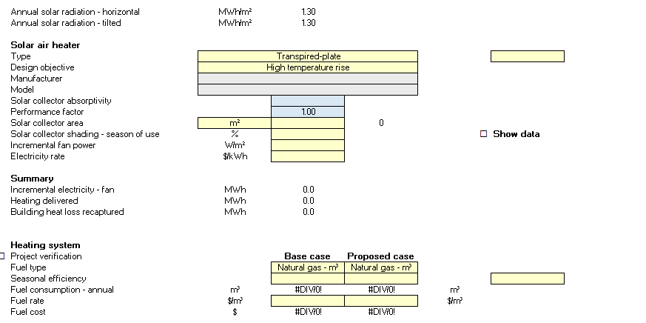
RETScreen Version 4

Slide 10
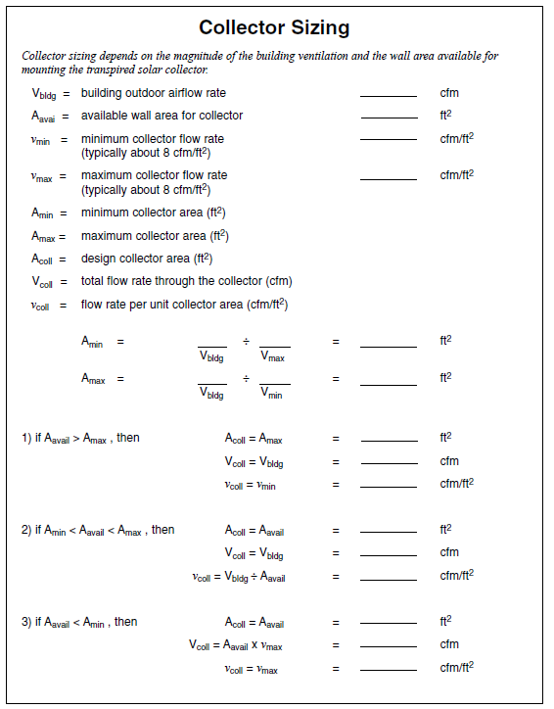
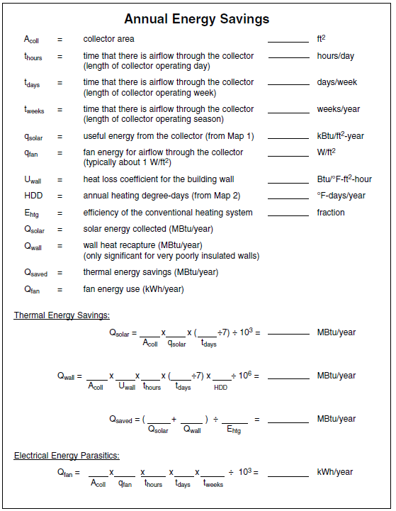
DOE Energy Savings Worksheet
Source: US Department of Energy Federal Technology
http://www1.eere.energy.gov/femp/pdfs/FTA_trans_coll.pdf

Slide 11
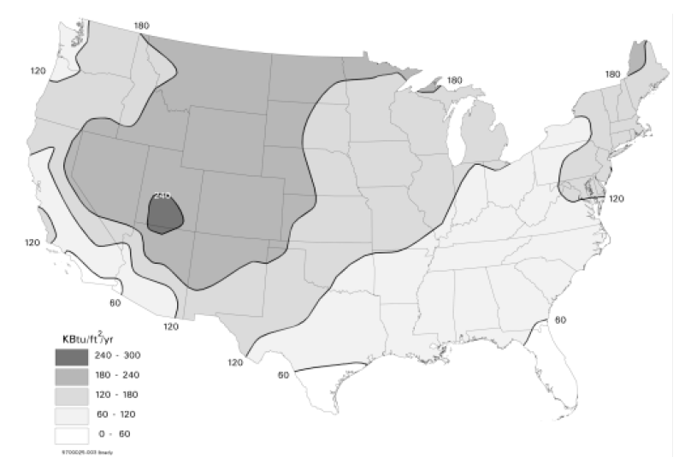
DOE Energy Savings Worksheet
Source: US Department of Energy Federal Technology
http://www1.eere.energy.gov/femp/pdfs/FTA_trans_coll.pdf

Slide 12
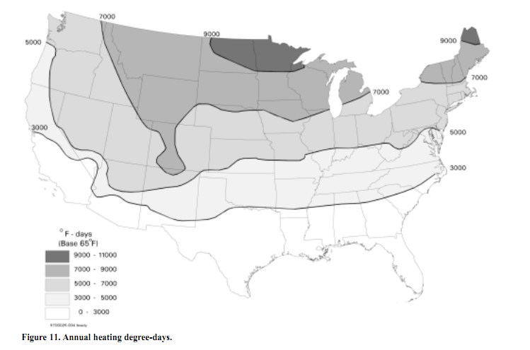
DOE Energy Savings Worksheet
Source: US Department of Energy Federal Technology
http://www1.eere.energy.gov/femp/pdfs/FTA_trans_coll.pdf

Slide 13
Our Study
A previous phase of the study obtained energy savings for a heating season at 3 locations in Minnesota
Using the energy savings from this phase we wanted to determine if the energy prediction models available are accurate
RETScreen’ s validity will be the focus of this presentation due to its wide industry use.

Slide 14
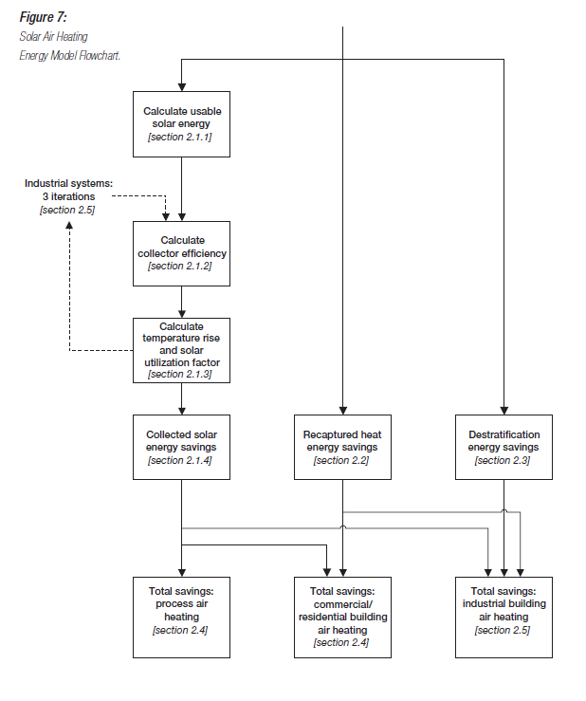
RETScreen Algorithm and Equations
Source: RETScreen Textbook

Slide 15
Equations employed in RETScreen
$$Q_{sol}=\sum_{i=1}^{12}{[ η_{i}} G_{coll} f_{util,i}]$$
$$η= \frac{α}{\left(1+\frac{\left(\frac{20{v′}_{wind}}{{\dot{Q}}_{coll}}\right)+7}{{\dot{Q}}_{coll} ρ C_{p}(1−0.005{\dot{Q}}_{coll})}\right)}$$
Where:
α is the collector absorptivity
${\dot{Q}}_{coll}$ is the flowrate through the collector
Corrected wind speed ${v′}_{wind}=.35 v_{wind}$
$$C_{p }\text{is} \text{the} \text{specific} \text{heat} \text{capacity} \text{of} \text{air} \text{equal} \text{to} \text{1.005} \text{kJ}\text{/}\text{kg}\text{−°}\text{C}\text{)}$$
ρ is the density of the air

Slide 16
Equations employed in RETScreen
$$G_{coll,i}=G_{tilt,i} A_{coll} f_{op,i}$$
$$f_{op,i}=n_{days,i} f_{sys,i} \frac{h_{op, daytime}}{h_{sunlight,i}} \frac{d_{op}}{7}$$
Where:
$G_{coll,i}$ is the amount of usable energy collected
$f_{op,i}$ is the operating schedule of the wall
$f_{sys,i}$ is the fraction of the month that the system is in use
$h_{sunlight,i}$ is the number of hours that there is sunlight.
(Based on an equation built into RETScreen)

Slide 17
Equations employed in RETScreen
$$f_{util,i}=\frac{ΔT_{act}}{ΔT_{avl}}$$
$$ΔT_{avl}=\frac{η{ G}_{tilt,i} }{{\dot{Q}}_{coll} ρ C_{p} h_{sunlight,i}}$$
$$T_{del,avl}={(T}_{amb}+ ΔT_{offset})+ΔT_{avl}$$
$$T_{del,act}=min{(T}_{del,max}, T_{del,avl})$$
$$T_{act}=ΔT_{del,avl}−{(T}_{amb}+ ΔT_{offset})$$
This quantity simulates the amount of collected solar energy that would contribute to heating savings
Simulates the amount that the incoming air can be heated
Represents the temperature of the air going into the HVAC system
$T_{del,max}$ is user defined, and gives a value for which the fan will turn off if exceeded

Slide 18
Equations for Recaptured Wall Loss
$$Q_{recap}=\sum_{i=1}^{12}{[( Q_{recap, op, daytime,i}+} Q_{recap, op, nighttime, i}) f_{sys,i}+Q_{recap, shutdown, i}]$$
$$Q_{recap, op, daytime,i}=\frac{d_{op}}{7} n_{days,i} h_{op, daytime, i}\left[\frac{A_{coll}}{R_{wall}} (T_{in}−T_{eff,i})\right]$$
$$Q_{recap, op, nighttime, i}=\frac{d_{op}}{7} n_{days,i} h_{op, nighttime, i}\left[\frac{A_{coll}}{R_{wall}} (T_{in}−T_{amb,i})\right]$$
$$Q_{recap, shutdown, i}=\frac{d_{op}}{7} n_{days,i}(24−h_{op})\left[(\frac{A_{coll}}{R_{wall}}−\frac{A_{coll}}{R_{wall}+R_{coll}})(T_{in}−T_{amb,i})\right]$$
$$T_{eff,i}=\frac{2}{3}T_{coll,i}+\frac{1}{3}T_{amb,i}$$

Slide 19
Accuracy and Improvement of RETScreen
To check the validity of RETScreen we performed the following steps
Perform the calculations as one would do in the field
Analyze the reason for the differences in the measured and calculated values
Identify factors that influence solar wall performance significantly

Slide 20
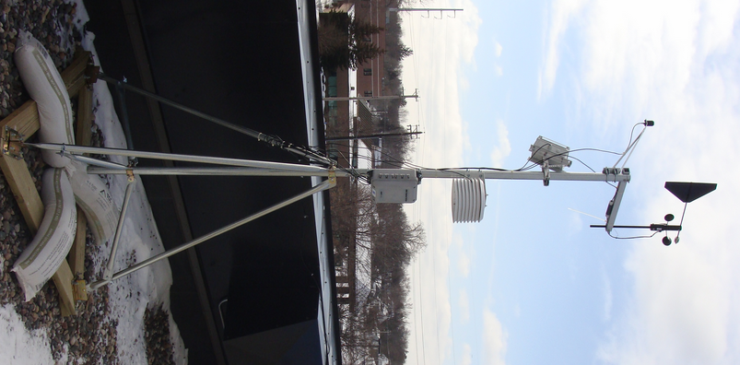
Accuracy and Improvement of RETScreen
Modify each method until calculated savings resemble the measured savings
Determine if an individual with little engineering training could make the alterations necessary to obtain accurate results
Weather Station at one of the study locations

Slide 21
RETScreen Input Data
The table shows the necessary inputs for RETScreen as well as the inputs for two of the sites from the study
 | Project Type | Analysis Type | Heating Value Reference | Units | Type of Building | Indoor Temperature (F) | Air Temperature-maximum (F) | Wall R Value (English)
Breck | Heating | Method 1 | HHV | Imperial | Institution | 65 | 65 | 15
Aveda | Heating | Method 1 | HHV | Imperial | Commercial | 68 | 65 | 11

Slide 22
RETScreen Input Data Continued
 | Fan Flow Rate (cfm) | Operating days per week - weekdays | Operating hours per day - weekdays | Operating days per week - weekends | Operating hours per day - weekends | solar tracking mode | Slope | azimuth
Breck | 1452 | 5 | 12.6 | 1.2 | 12.2 | fixed | 90 | 45
Aveda | 8000 | 5 | 18.8 | 2 | 13.5 | fixed | 90 | 0

Slide 23
Results from performing baseline calculations
The figure to the right shows the energy savings with the baseline calculations compared with the actual measured energy savings
It can be seen that RETScreen only predicts about 50% of the actual savings
SITE | RETScreen Version 4 (MBTU) | Actual (MBTU)
Aveda | 164.20 | 302.2
Breck | 35.30 | 60.2

Slide 24
Factors that influence the model
Approach Velocity
defined as the fan flow rate divided by the size of the collector
ideal approach velocity is around 4 feet/min to prevent loss of efficiency from wind effects
Wind Speed
- defined as a part of the initial set up of the RETScreen model. Based on NASA data at the specific location input
Solar Radiation
- also a defined parameter based on NASA data at the specific location input

Slide 25
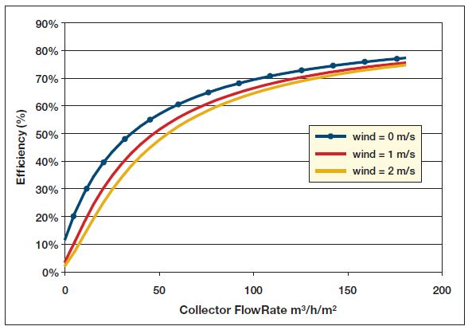
Approach Velocity
Source: RETScreen Textbook

Slide 26
Solar Radiation and Wind
Solar radiation can vary significantly from year to year
The 30 year averages for solar radiation are often not representative of the actual solar radiation
The wind data is not accurate due to being measured generally at airports where there is large open space

Slide 27
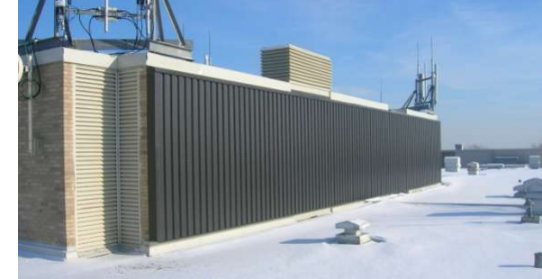
Improving Solar Radiation Data
To obtain more accurate calculations for savings data for solar radiation from 2009-2010 (the years of the study) were obtained from NASA. Wind data from the same years were also obtained from NASA
NASA has a website where global coordinates of a location can be input and solar radiation and wind data can be obtained at http://earth-www.larc.nasa.gov/cgi-bin/cgiwrap/solar/timeseries.cgi?email=daily@larc.nasa.gov

Slide 28
Improving Wind Data
Wind data in the study was found using the same NASA website mentioned previous
Wind speed found had to be corrected to more represent an urban setting, given Breck and Aveda are both surrounded by building and trees
This was done by inputting wind speeds into another RETScreen program intended for wind turbines.
This program is able to generate wind speeds at different heights based on surrounding. A suggested correction factor for urban areas is given by the program

Slide 29
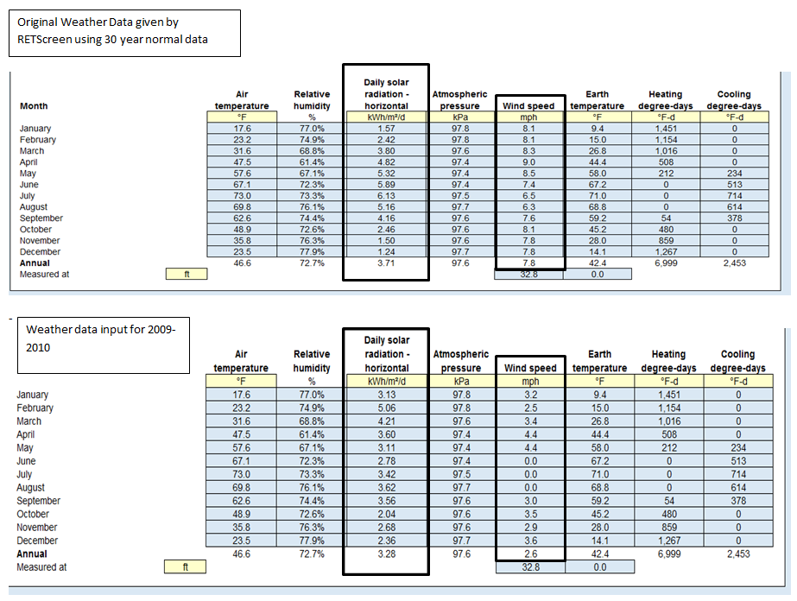

Slide 30
Results from changing the models
The calculation for the energy savings at Breck were significantly improved from changing the inputs
Aveda saw improvements but they were not a drastic as Breck
SITE | 20% wind | 100% wind | 180% wind | RETScreen defaults | Actual Savings
Aveda | 178.2 | 159.3 | 103 | 164.2 | 302.2
Breck | 65.4 | 63.6 | 40.8 | 35.30 | 60.2

Slide 31
Field Implementation and Improving Results
Based on the findings from the study RETScreen can at best be used as a very rough first stage savings prediction
To improve the results of RETScreen a wind study of the site would be necessary to truly get the best data to predict potential savings
The changes made require a fair amount of extra time and knowledge to complete and therefore it cannot be expected that individuals in the field would perform the necessary steps to improve RETScreen

Slide 32
Acknowledgments
Completion of this project would not have been possible without the assistance of various public and private entities.
Breck School
3rd Precinct Police Station
AVEDA Corporation
Interdistrict Downtown School (FAIR School Downtown)
St. Anthony – New Brighton School District
Hibbing Courthouse
Cunningham Group
Michaud Cooley Erickson
Automated Logic
McKinstry Co.
Architectural Resource Inc.
Conserval Engineering Inc.
City of Minneapolis
Office of Facilities Management – Minnesota State University, Mankato
RETScreen International

Slide 33
References
http://earth-www.larc.nasa.gov/cgi-bin/cgiwrap/solar/timeseries.cgi?email=daily@larc.nasa.gov
RETScreen Textbook, Solar Air Heaters
US Department of Energy Federal Technology http://www1.eere.energy.gov/femp/pdfs/FTA_trans_coll.pdf
RETScreen.com Course SAH PowerPoint
Performance of Solar Walls in Minnesota State Report by Dr. Patrick Tebbe

Slide 34
Questions

